Slide 1
Assosa University College of Computing & Informatics Department of Information Technology
Network Device and Configuration
By Cheru H. (MSc.)

Slide 2
Objective
At the end of this chapter student will be able to:
Know internet sharing mechanism
Know about different network devices.
Introduced in to CLI

Slide 3
Chapter One: Device Configuration
What is device?
An instrumentally invented for a particular purpose
If so list some of network device?
Hub => layer one on OSI reference model
Switch => layer two on OSI reference model
Repeater => layer one on OSI reference model
Router => layer three on OSI reference model
Bridge => layer two on OSI reference model
So on

Slide 4
Configuration Wizard for Internet Sharing
Internet connection sharing (ICS) comes with all versions of Windows since Windows 98 Second Edition.
With ICS, only one computer, known as the gateway computer, has a direct connection to the Internet, such as a dialup modem connection or a DSL connection.
The other computers on your network connect to the Internet through the gateway computer.

Slide 5
Cont’d…
To activate Internet connection sharing, follow this procedure on the computer that has the Internet connection that you want to share: homework use your computer to share internet.

Slide 6
Router configuration wizard
Continue with configuration dialog? [yes/no]: no => use manual configer
What about the answer is yes =>
At any point you may enter a question mark '?' for help.
Use ctrl-c to abort configuration dialog at any prompt.
Would you like to enter basic management setup? [yes/no]: yes Configuring global parameters:
Enter host name [Router]: Router2

Slide 7
View device
Show commands are used to verify operation and configuration of interface:
show ip interfaces brief
show ip route
show running-config
Show commands that are used to gather more detailed interface information:
show interfaces
show ip interfaces

Slide 8
Automatic Discovery and Configuration Manager
Configure discovery methods to find resources to manage from your network, Active Directory, and Azure Active Directory (Azure AD).
First enable and then configure each method that you want to use to search your environment.
You can also disable a method by using the same procedure that you use to enable it.

Slide 9
Wireless Mobility configuration menu
A mobility group is a set of controllers, identified by the same mobility group name, that defines the realm of seamless roaming for wireless clients.
By creating a mobility group, you can enable multiple controllers in a network to dynamically share information and forward data traffic when inter-controller or inter-subnet roaming occurs.
Controllers in the same mobility group can share the context and state of client devices as well as their list of access points so that they do not consider each other’s access points as rogue devices.

Slide 10
VPN Technology
Due to security risks, VPNs are needed when a teleworker or a remote office uses a broadband service to access the corporate WAN over the Internet.
A VPN is an encrypted connection between private networks over a public network, such as the Internet.

Slide 11
cont’d …
There are several benefits to using VPNs:
Cost savings
Security
Scalability
Compatibility with broadband technology
There are two types of VPN access:
Site-to-site VPNs – Connects entire networks to each other; for example, they can connect a branch office network to a company headquarters network.
Remote-access VPNs – Enables telecommuters, mobile users, and extranet consumers to access a company network securely over the Internet.

Slide 12
Cont’d…
In a Mobile VPN with IPSec policy, the Policy tab has these properties, which are different than the properties of a Firewall policy:
Group
Allowed Resources

Slide 13

Element Manager
With Element Manager, you can manage individual server switches from an easy-to-use GUI. To run Element Manager, you must complete the following tasks:
• Install the Element Manager software on a host or workstation.
• Configure your server switches to support Element Manager.
• Launch Element Manager on your host or workstation.

Slide 14
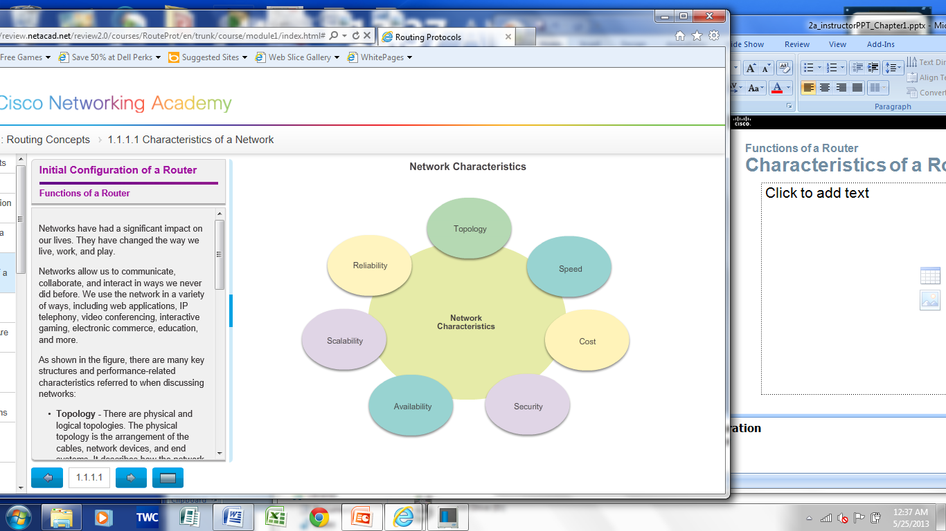
Characteristics of a Network

Slide 15
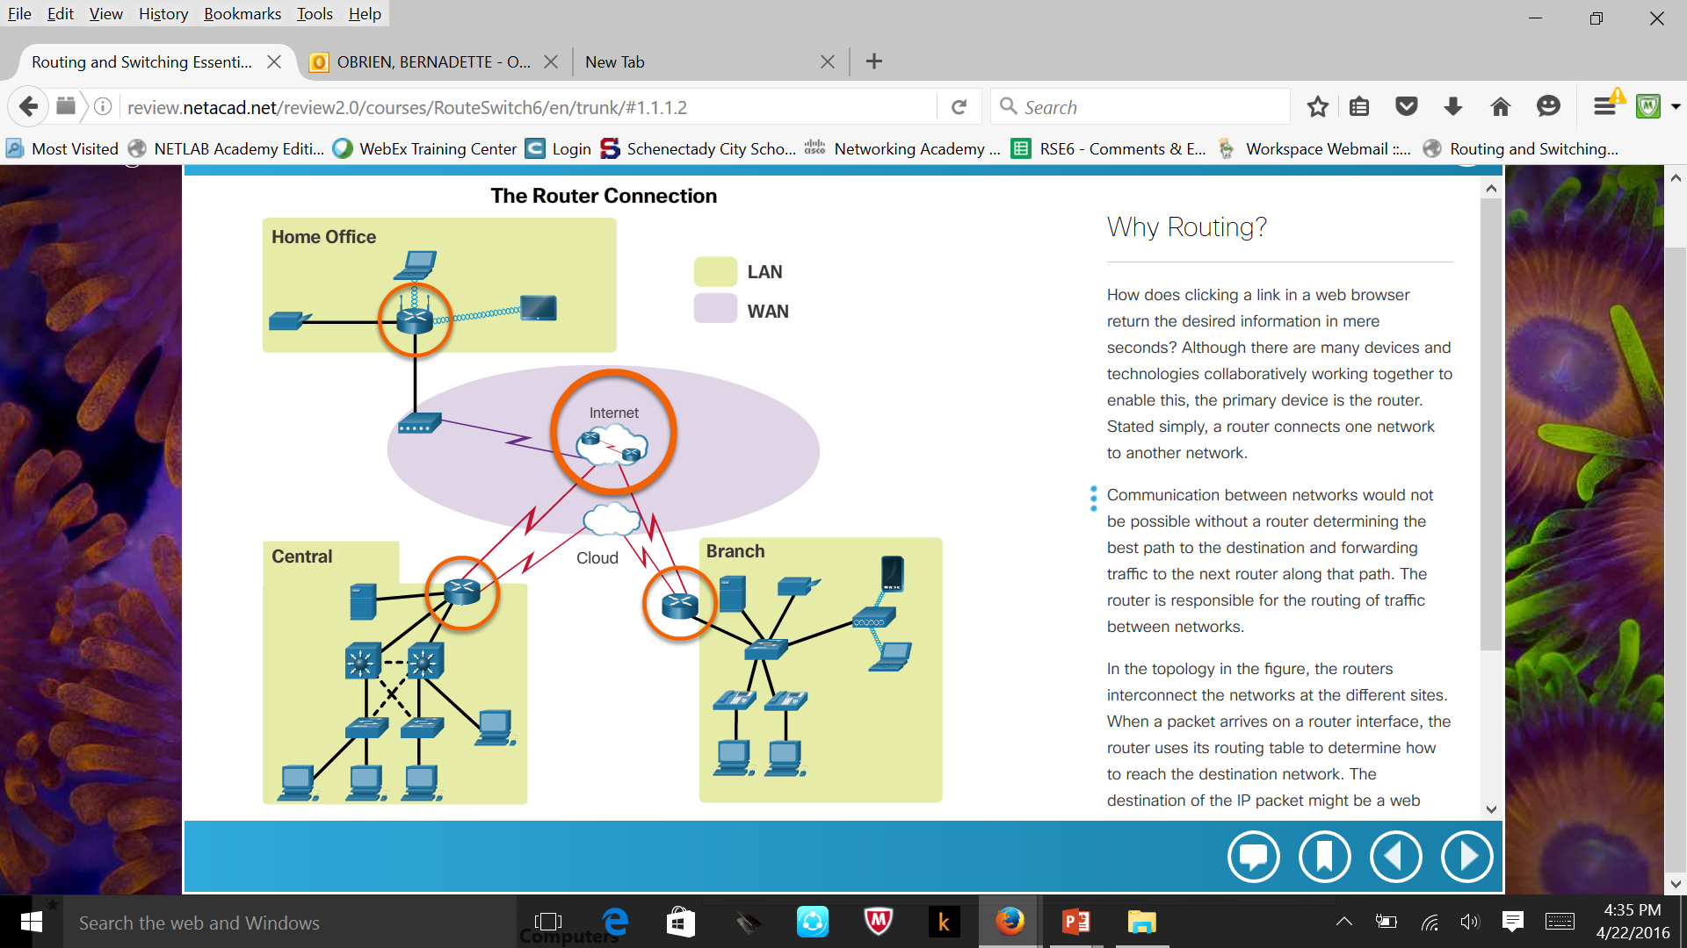
Why Routing?
The router is responsible for the routing of traffic between networks.

Slide 16
Routers are Computers
Routers are specialized computers containing the following required components to operate:
Central processing unit (CPU)
Operating system (OS) - Routers use Cisco IOS
Memory and storage (RAM, ROM, NVRAM, Flash, hard drive)
Routers use specialized ports and network interface cards to interconnect to other networks.

Slide 17
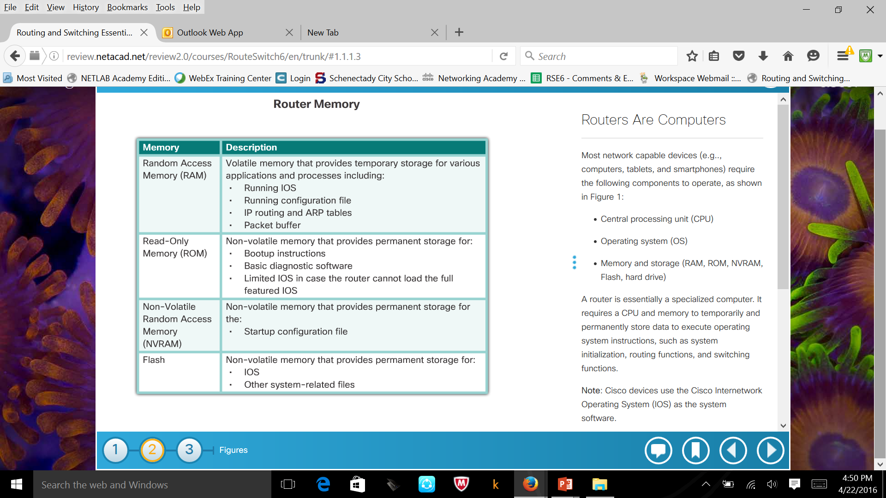
Routers are Computers

Slide 18
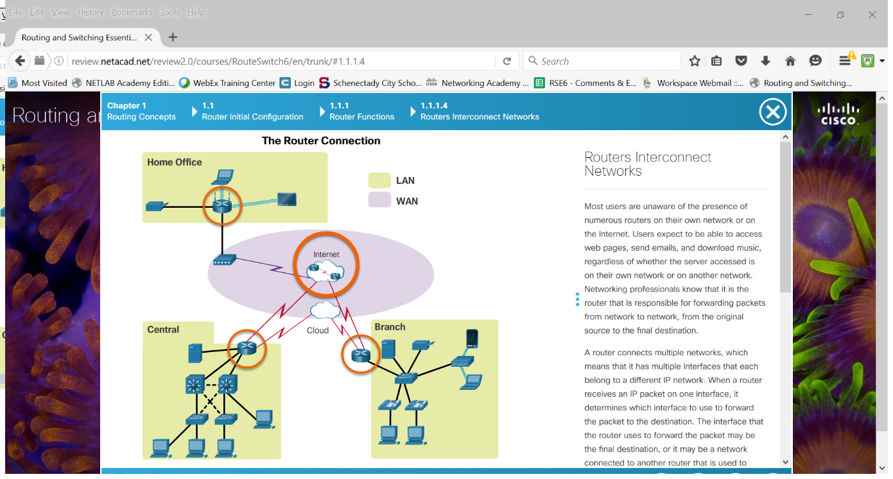
Routers Interconnect Networks

Slide 19
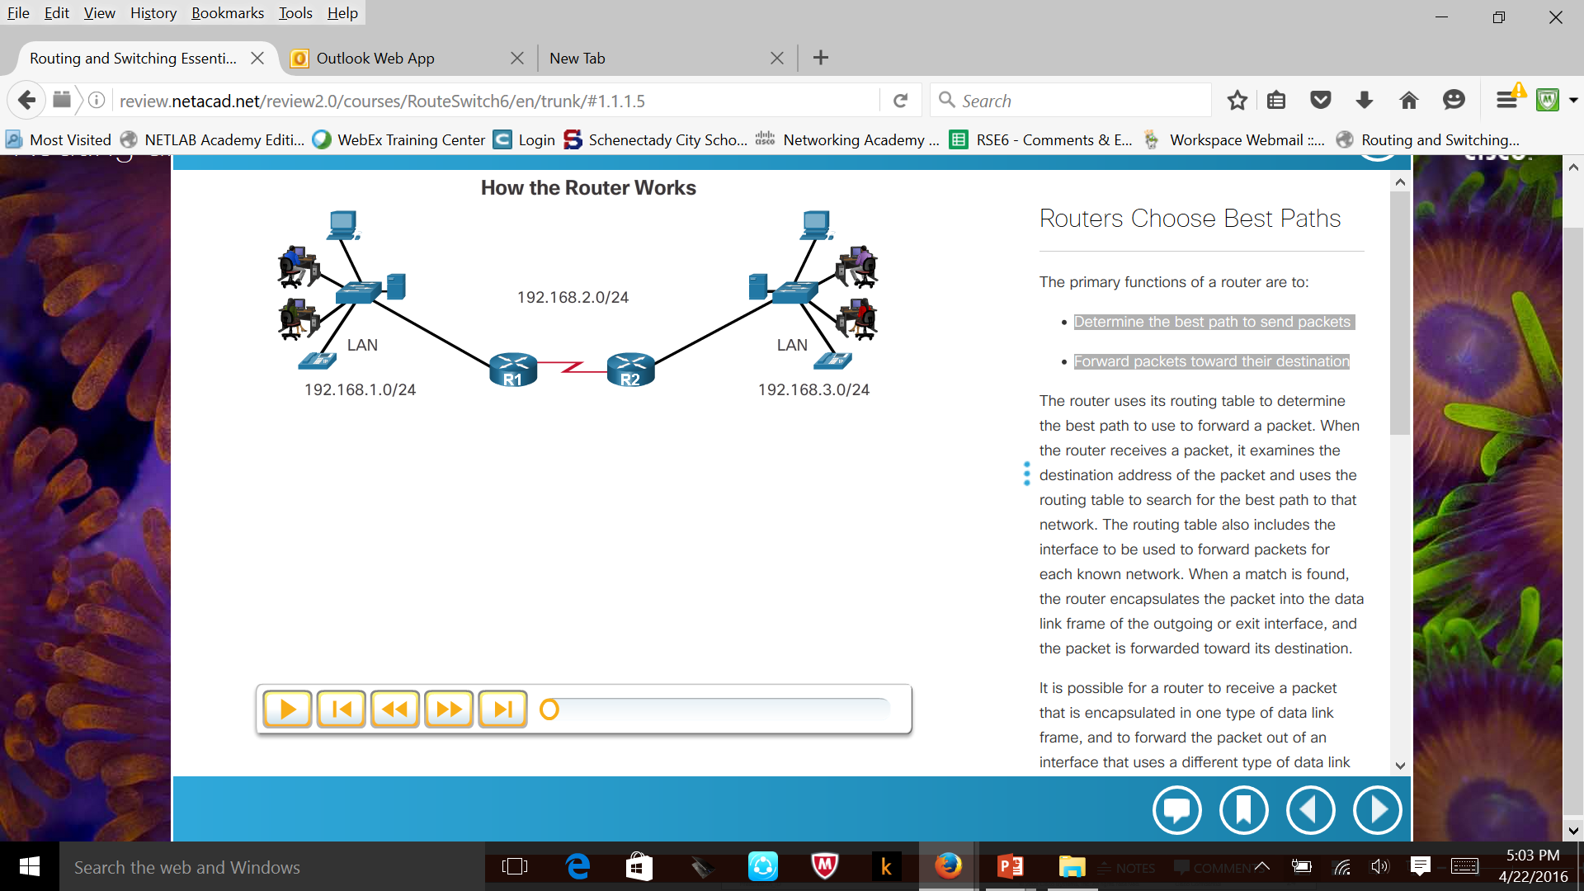
Routers Choose Best Paths
Routers use static routes and dynamic routing protocols to learn about remote networks and build their routing tables.
Routers use routing tables to determine the best path to send packets.
Routers encapsulate the packet and forward it to the interface indicated in routing table.

Slide 20
Default Gateways
To enable network access devices, must be configured with the following IP address information:
IP address - Identifies a unique host on a local network.
Subnet mask - Identifies the host’s network subnet.
Default gateway - Identifies the router a packet is sent to when the destination is not on the same local network subnet.

Slide 21
Document Network Addressing
Network documentation should include at least the following in a topology diagram and addressing table:
Device names
Interfaces
IP addresses and
subnet masks
Default gateways

Slide 22
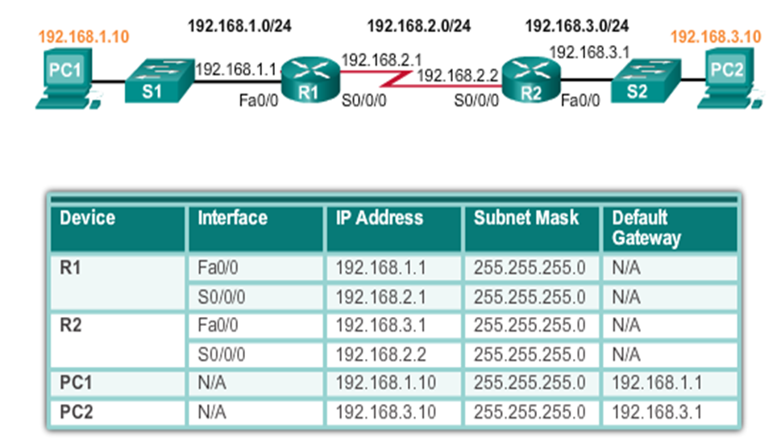
Cont’d…

Slide 23
Enable IP on a Host
Statically Assigned IP address – The host is manually assigned an IP address, subnet mask and default gateway. A DNS server IP address can also be assigned.
Used to identify specific network resources such as network servers and printers.
Can be used in very small networks with few hosts.
Dynamically Assigned IP Address – IP Address information is dynamically assigned by a server using Dynamic Host Configuration Protocol (DHCP).
Most hosts acquire their IP address information through DHCP.
DHCP services can be provided by Cisco routers.

Slide 24
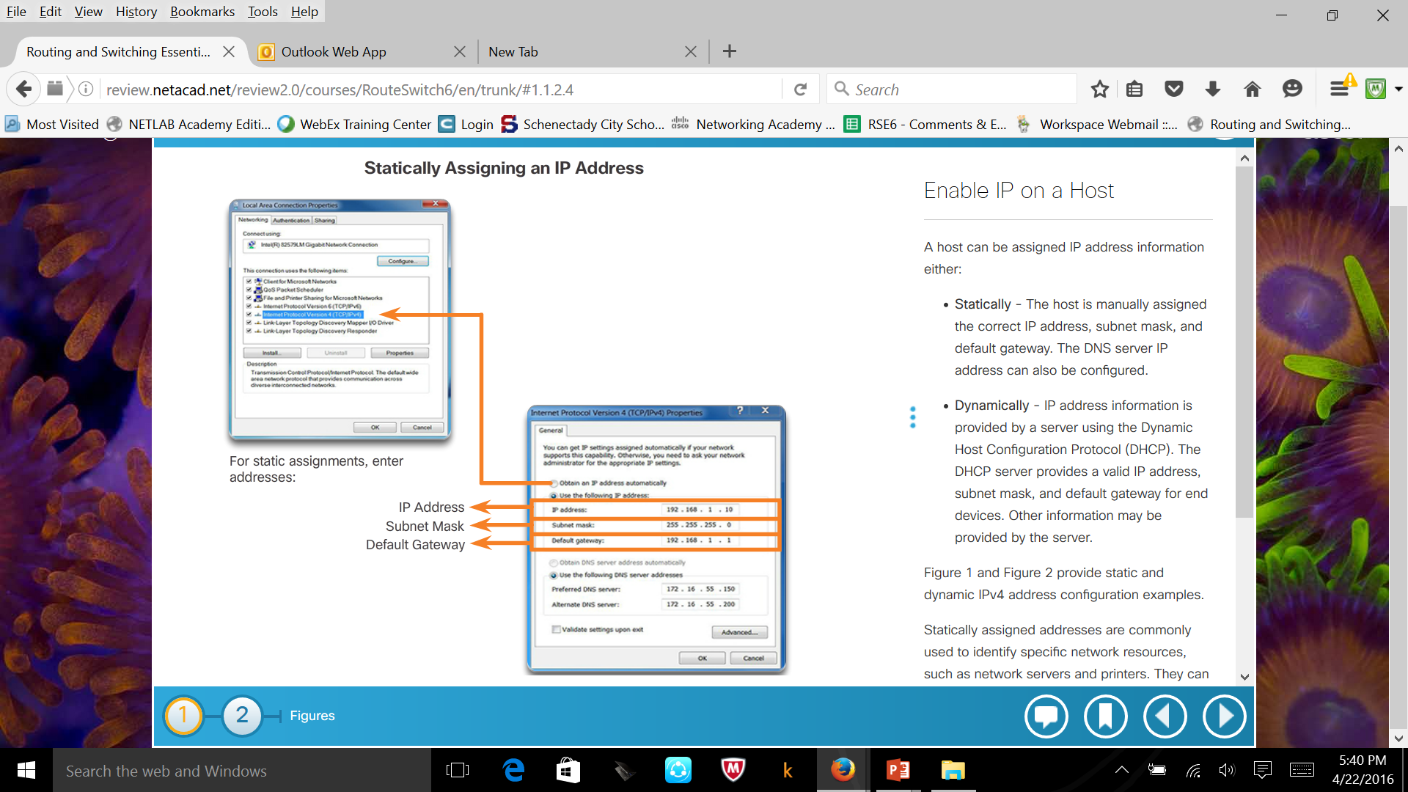
Cont’d…

Slide 25
Introduced in to CLI
Network infrastructure devices require IP addresses to enable remote management.
On a switch, the management IP address is assigned on a virtual interface called a switched virtual interface (SVI).
Name the device – Distinguishes it from other routers
Secure management access – Secures privileged EXEC, user EXEC, and Telnet access, and encrypts passwords .
Configure a banner – Provides legal notification of unauthorized access.
Save the Configuration

Slide 26
Cont’d…
To be available, a router interface must be:
Configured with an address and subnet mask.
Activated using no shutdown command. By default LAN and WAN interfaces are not activated.
Configured with the clock rate command on the Serial cable end labeled DCE.
Optional description can be included.

Slide 27
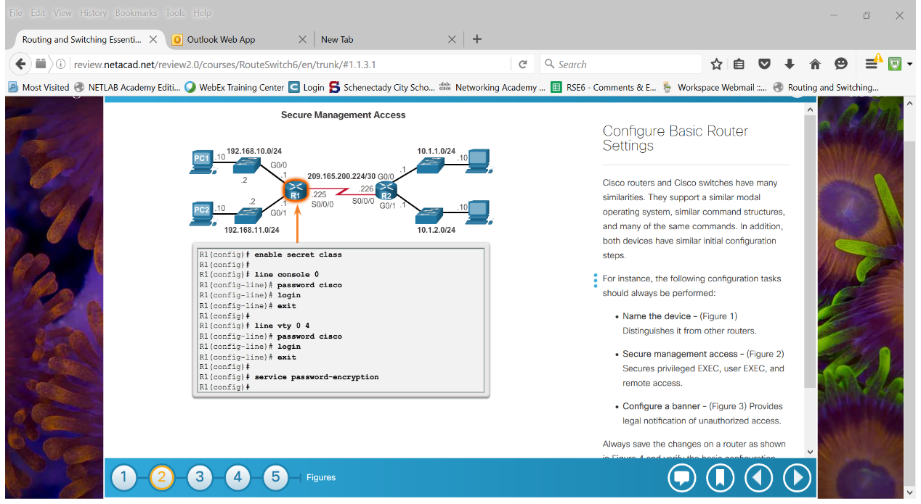
Cont’d…

